Slide 1
Missile Guidance System
Aarathi Devakumar, Aarav Jain, Brandon Bae, Ryo Kato

Slide 2
Problem STATEMENT
Limited precision in adverse weather conditions
Dependency on satellite-based systems (prone to disruptions)
High costs with traditional systems

Slide 3
Solution
Arduino based navigation motion system
Input integration for environmental adaptability
Modular design for scalability and cost-effective

Slide 4
HACKATHON TImeline
3D Prints
Arduino Wiring and Soldering
Arduino Software
Picked up various hardware items
Discussed ideas
Brainstorm
BUILD
DESIGN
TEST/PRESENT
CAD Sketches
Learned how to use arduinos
Software Testing and Troubleshooting

Slide 5
Materials used:
Breadboard
Arduino Uno
IMU
LCD
PIR Motion Sensor
Xbee Bluetooth Sensor
Number Pad
PLA 3D Prints
3 MG90S Servos
1 SG90 Servo
Wires

Slide 6
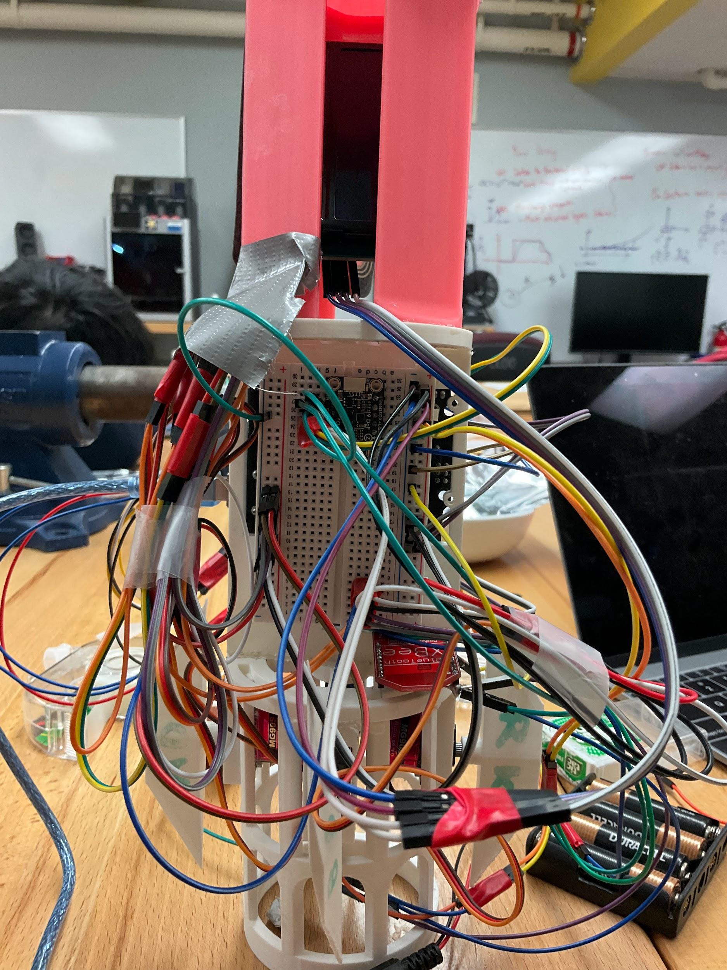
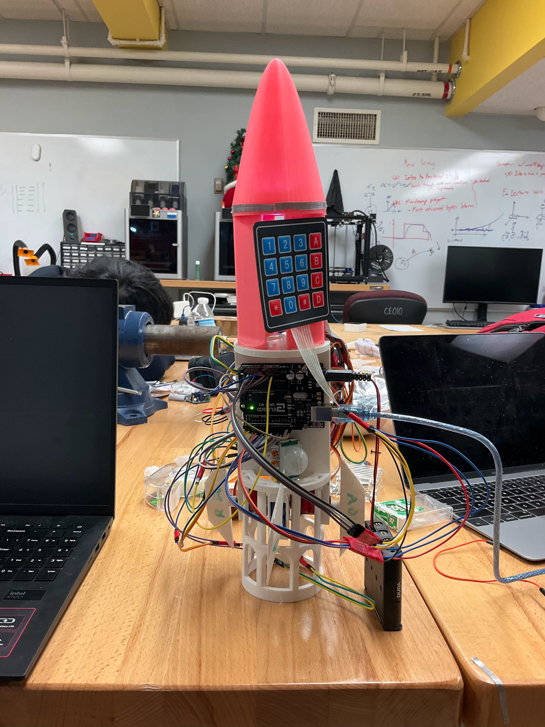
THE ARDUINO SIDE (LAYOUT):

Slide 7
Challenges ENcountered:
Rotation data difficulty
Difficulty sending IMU data to the Arduino
Wiring
Difficulties with Bluetooth Connectivity
Initially tried 9V battery as power source and temporarily burned the LCD screen

Slide 8
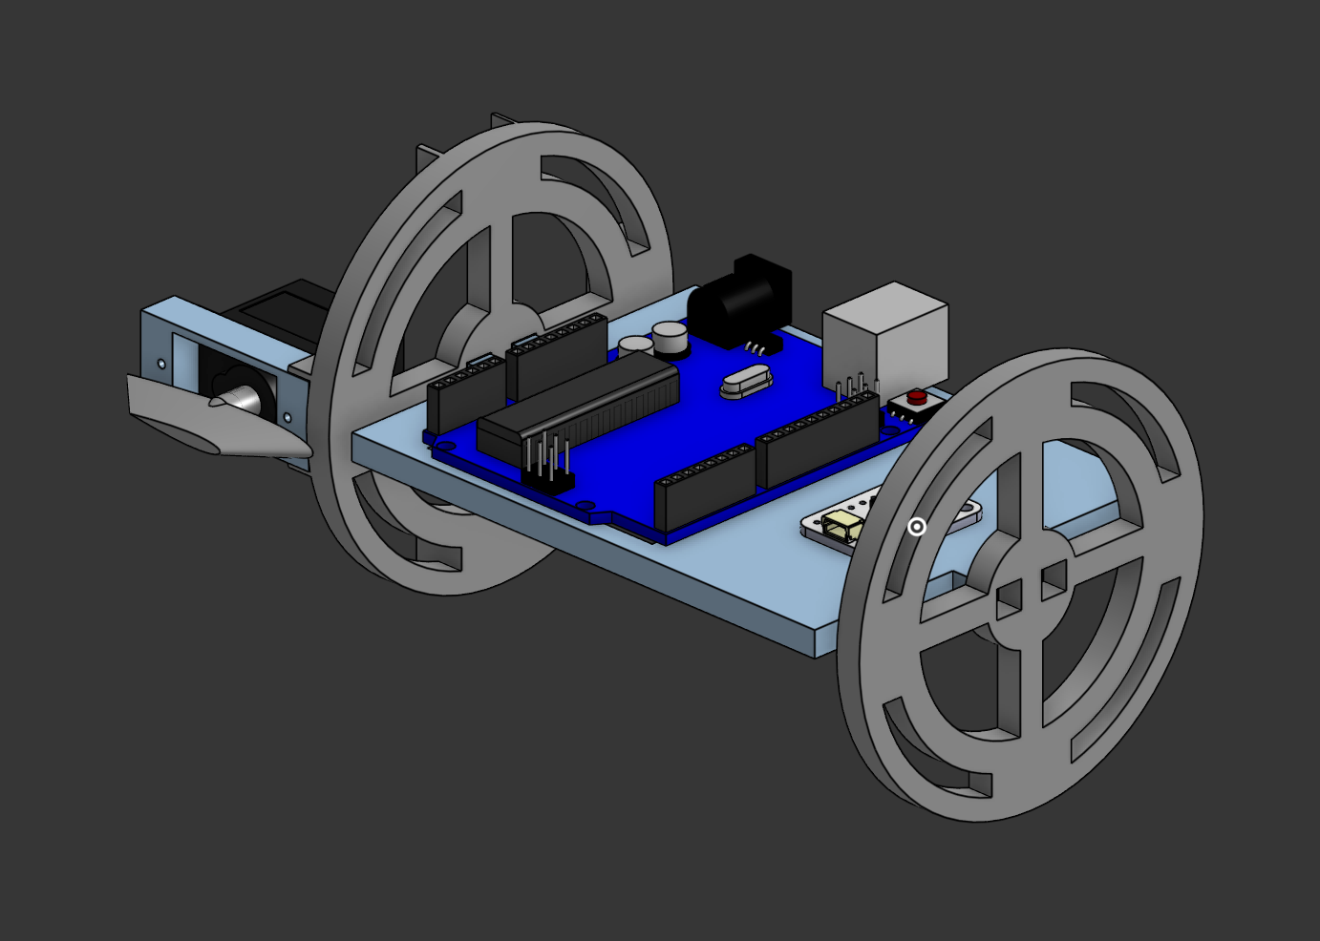

Slide 9
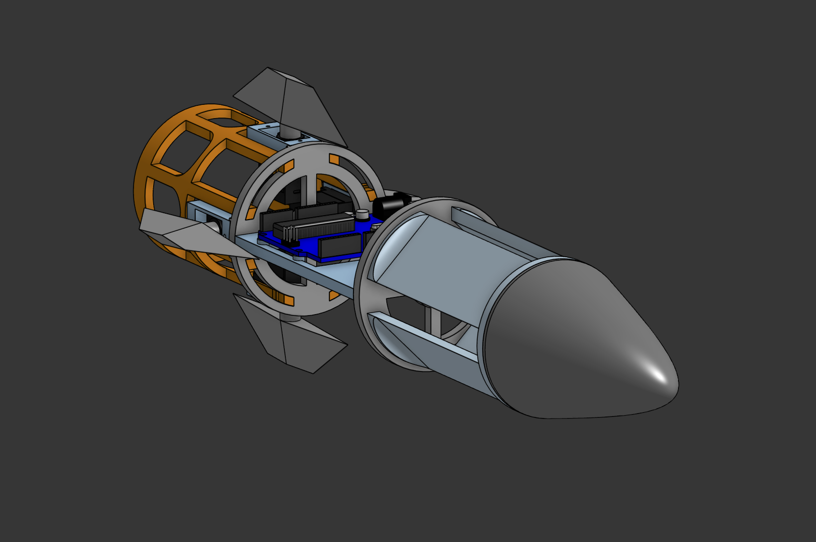

Slide 10
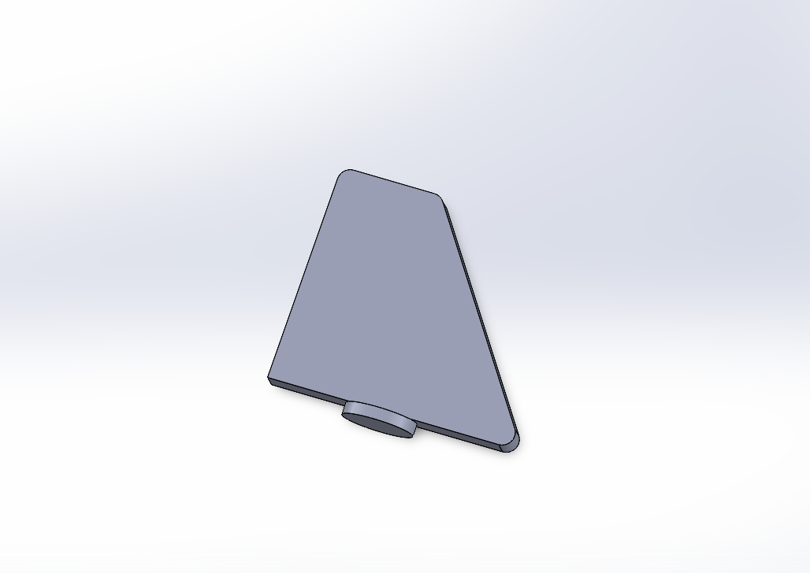

Slide 11
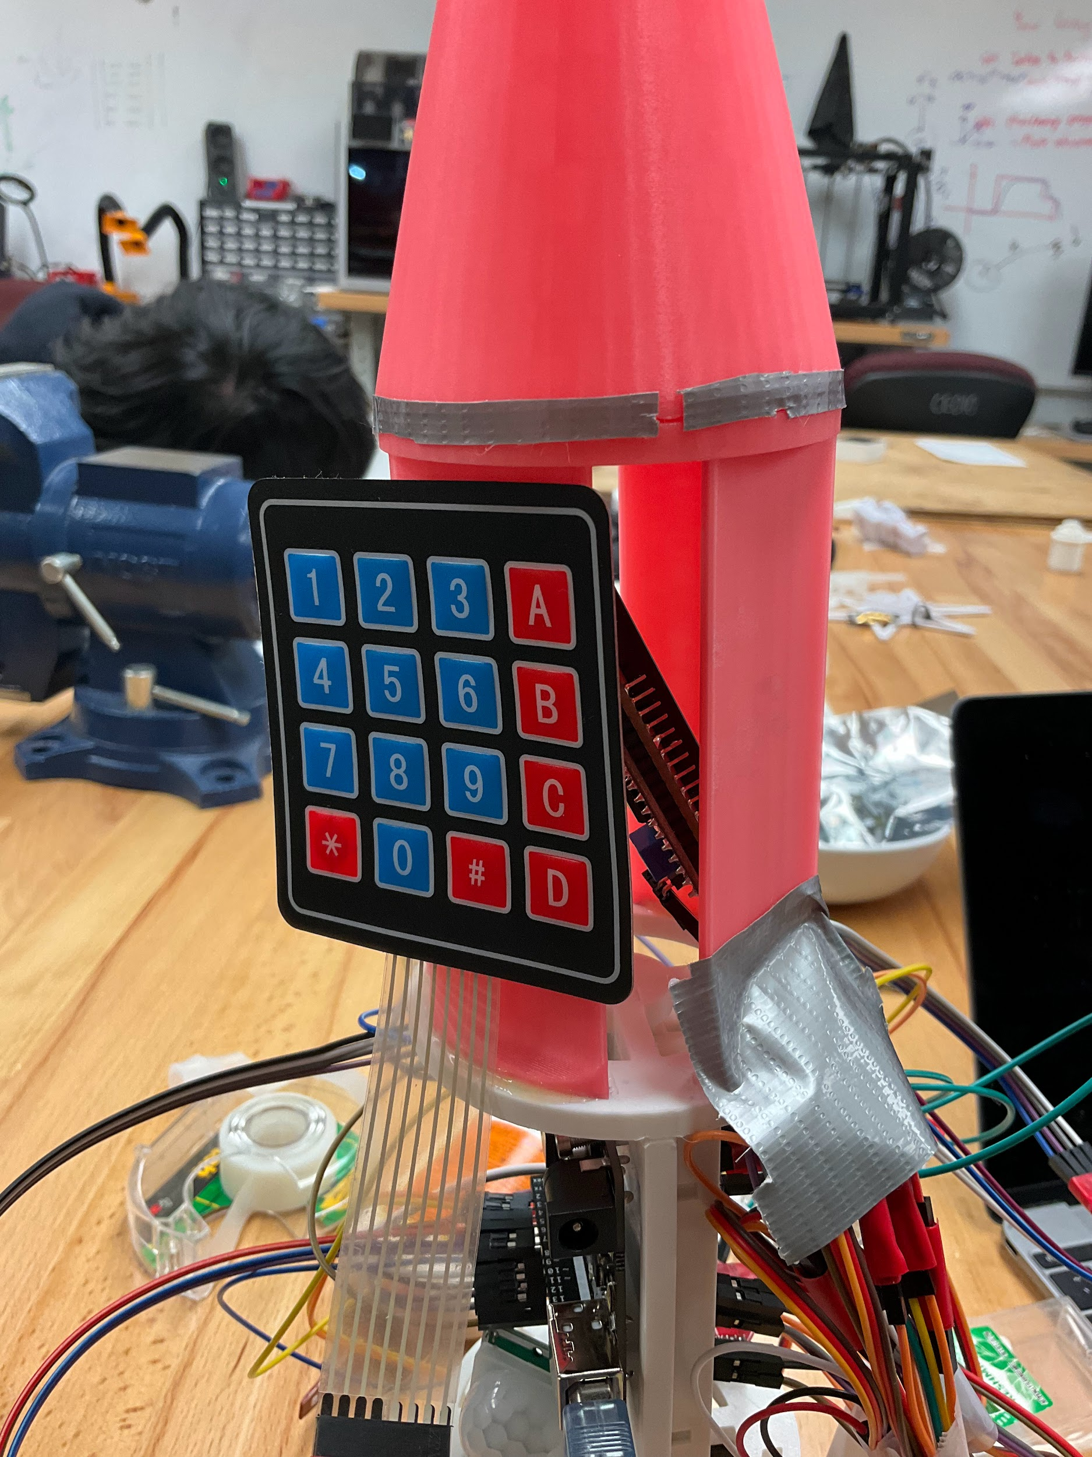
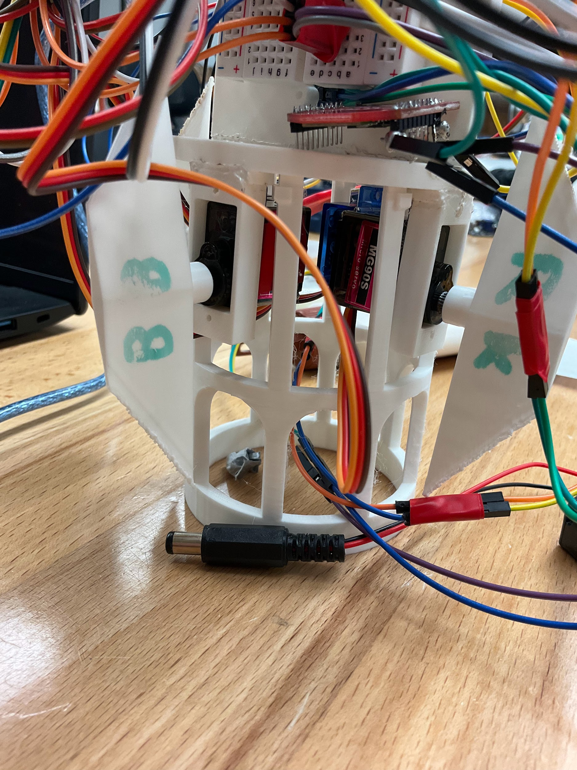

Slide 12
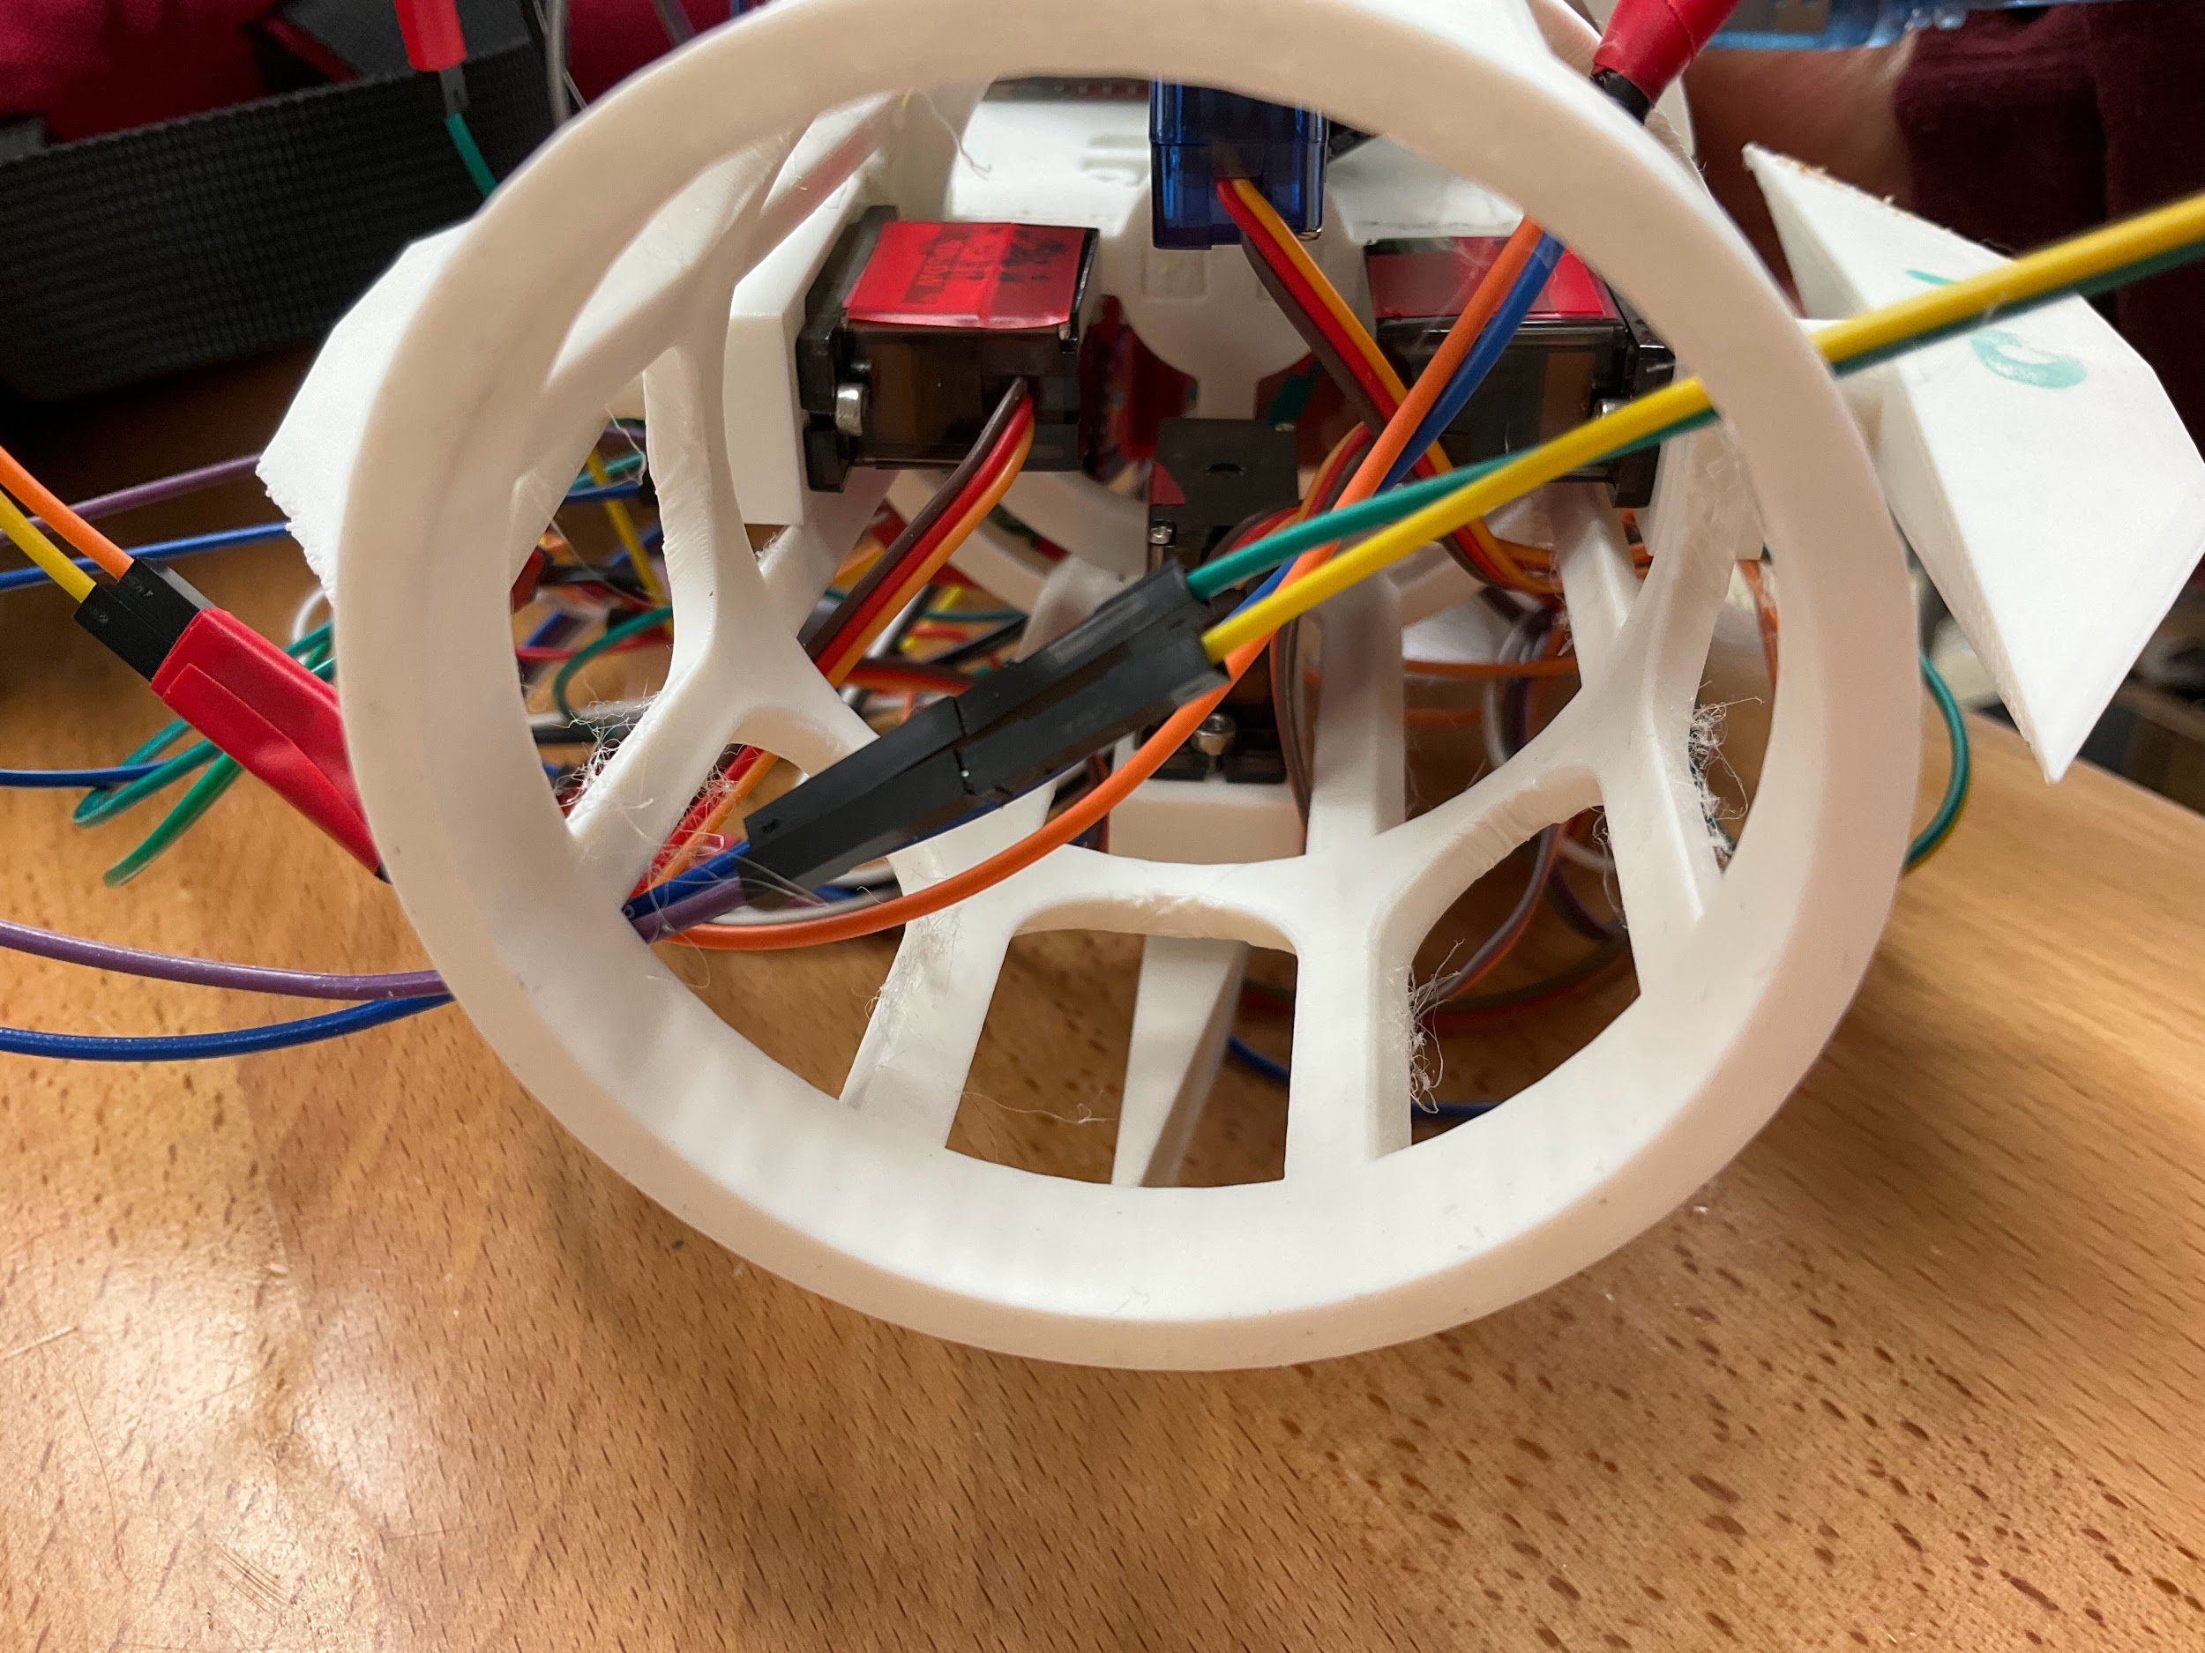
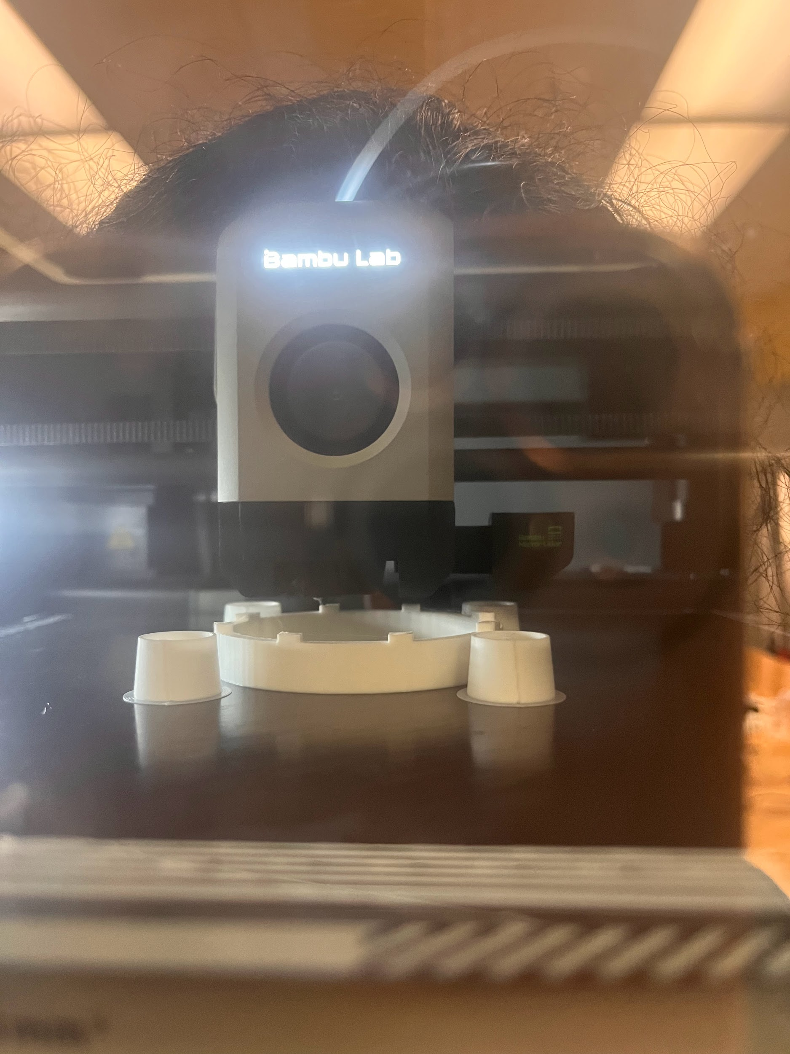
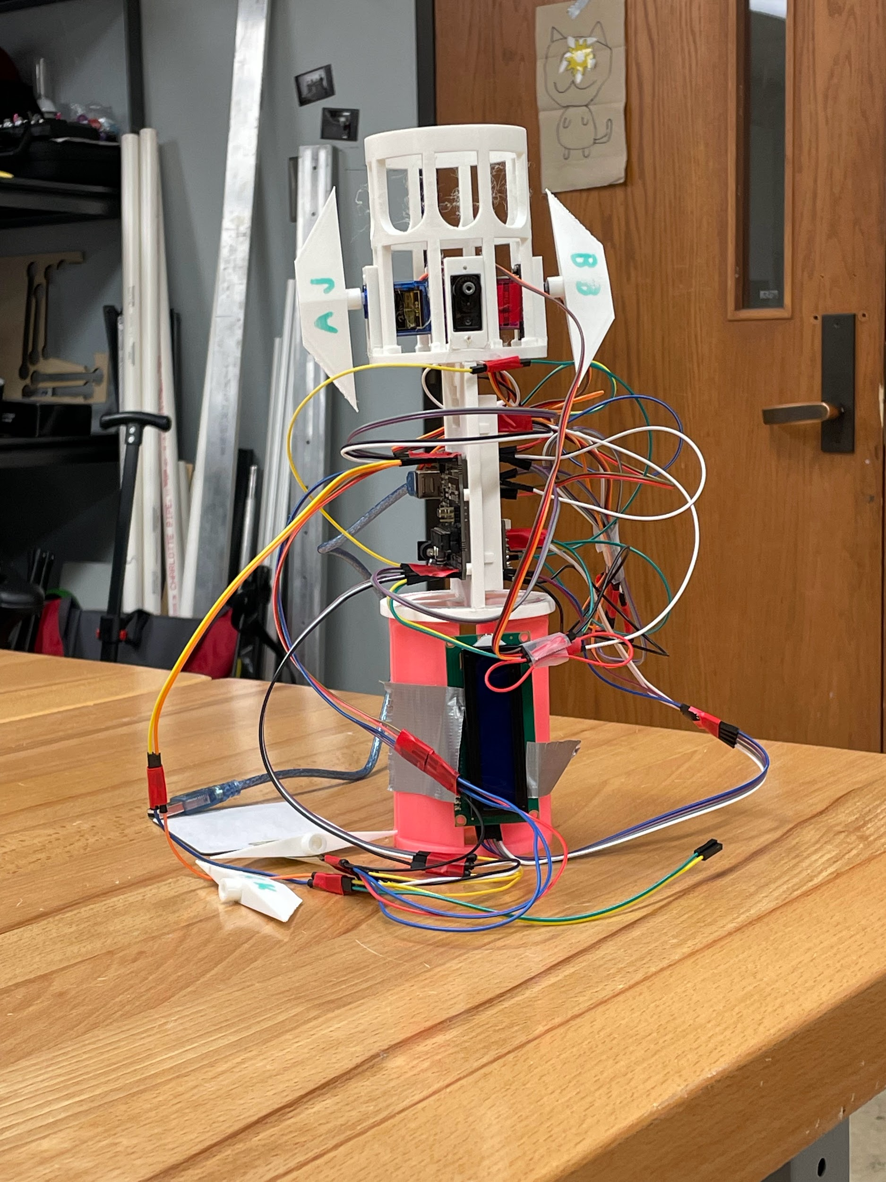

Slide 13
Use Cases
Commercial
Space Exploration
Defense Applications
High-precision drone delivery systems
Enhanced navigation for orbital corrections
Targeted missile systems with higher precision
Reduced collateral damage

Slide 14

TEST DEMOS

Slide 15
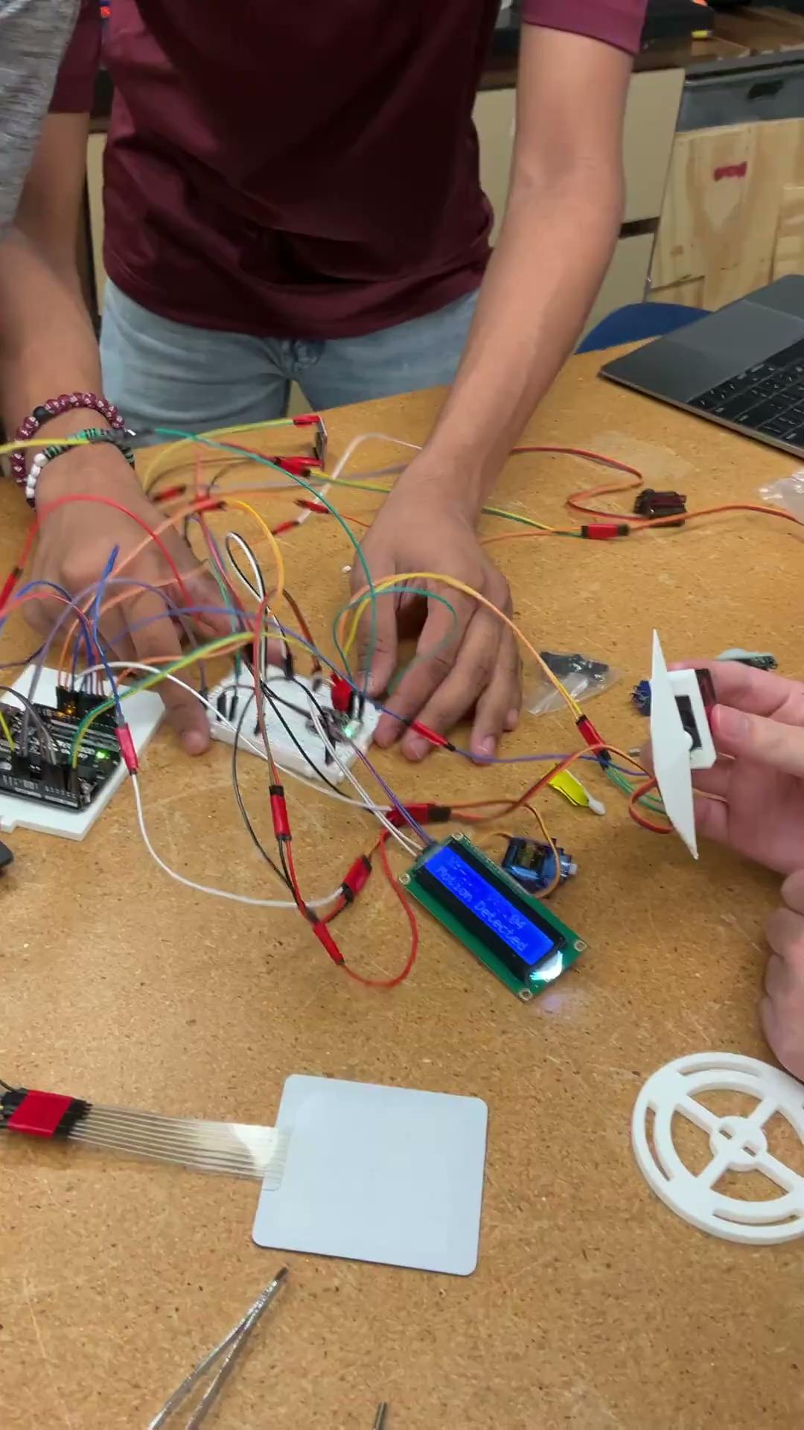

Slide 16





OUR EXPERIENCE
Brandon (CPSC ‘28)
Ryo (MEEN ‘28)
Aarathi (MEEN ‘28)
Aarav (ELEN ‘28)

Slide 17
CONCLUSION
Our missile guidance system combines cutting-edge technology with practical applications to redefine precision and reliance in missile guidance systems.
Thank you so much, and Gig’ Em!

